Slide 1
Memory
WHAT IT IS.
WHAT’S WRONG WITH.
AND OTHER COOL STUFF.

Slide 2
Memory and Pop Culture
What are some movies that have to do with memory?
How else do we see memory influencing culture?

Slide 3
The Brain
Hippocampus
  The hippocampus is where memories are moved into permanent storage.
  Called the consolidation area.
  If this is severed (aka doesn’t work), people have a hard time forming new memories.

Slide 4
The Brain
Prefrontal regions
  Creation of new memories.
  Left and right hemispheres create either verbal or visual memories.

Slide 5
The Brain
Specific memories? Where are they stored?
  Lashley found that memories are not stored in any specific part of the brain using rats.
  Synchronized neural activity.

Slide 6
Types of Memory
Sensory Memory
Short Term Memory
Long Term Memory
  This is the Atkinson and Shiffrin Model of memory.

Slide 7
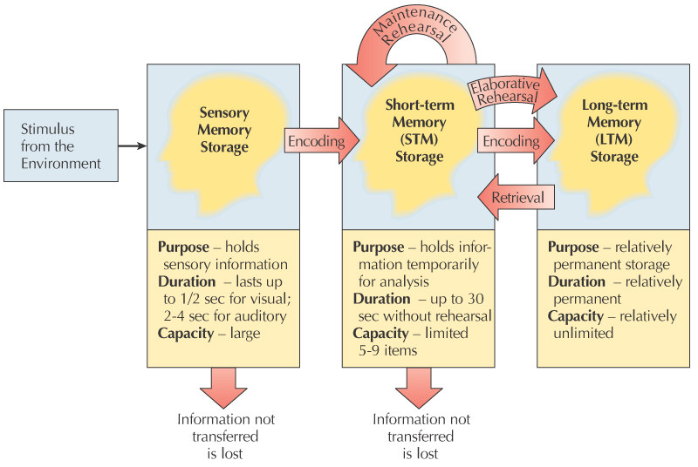
Atkinson & Shiffrin

Slide 8
Sensory Memory
Transient memory store for several types of information:
  Visual and Auditory

Slide 9
Sensory Memory
All these memories types are:
  Brief
  Large Store (we can store a lot at once)

Slide 10
Sensory Memory
Visual Sensory Store
  Iconic Memory - stores like icons.
Auditory Sensory Store
  Echoic Memory - like an echo of what you heard.

Slide 11
Sensory Memory
Sperling’s Task
  Whole report procedure
  Partial report procedure
Supports the large capacity and brief nature of sensory memory.

Slide 12
X | 4 | T | 9
7 | R | F | 3
N | 8 | 5 | B

Slide 13
Short Term Memory
Intermediate store that hold information as it travels between sensory and long term memory.

Slide 14
Short Term Memory
Capacity - much smaller (7+-2)
Duration - rehearsal will lead to unlimited duration.
Also known as:
  Working memory

Slide 15
STM: Capacity
Memory span - number of elements one can immediately repeat back.
Memory span can be increased by “chunking”.
  Putting things together in a meaningful way.

Slide 16
Magic number 7+/-2 (Miller)
5 to 9 “chunks” of info
Chunk size affected by:
  Meaningfulness
  Relationship to other chunks
  Background knowledge/expertise

Slide 17
2 1 1 4 9 2 1 8
2
1
1
4
9
2
1
8

Slide 18
2 1 1 4 9 2 1 8
21
14
92
18

Slide 19
STM: Working Memory?
The problem:
  Different people have different memory spans.
  Baddeley’s Theory of Working Memory.

Slide 20
Working Memory
Baddeley’s Working Memory (1974):
  3 separate and independent capacity components:
    PHONOLOGICAL LOOP:
    VISUO-SPATIAL SKETCHPAD:
    CENTRAL EXECUTIVE:
Central
Executive
Phonological
Loop
Visuo-spatial
Sketch Pad
Long-term Memory
Notes:
Be most familiar with Baddeley’s (Al as we like to call him!) model of working memory and each component.
What have the various studies shown regarding these independent entities?

Slide 21
Working Memory
Central Executive - governs what comes in and out of short term memory.
  Controls which of the subsystems are being used.

Slide 22
Working Memory
Phonological Loop - verbal information processor
  Repeating a phone number in your head

Slide 23
Working Memory
Visuospatial Sketchpad - visual and spatial info processor.
  Mental rotation, cognitive maps, etc.

Slide 24
Working Memory
Remember dual task interference?
  This theory explains why you can’t do two things of the same type at once.

Slide 25
The Phonological Loop: When It Works and When It Doesn’t
The idea that verbal working memory involves both a “mind’s ear” (that heard the digits when you read them) and a “mind’s voice” (that repeated them in rehearsal) is central to current thinking about the phonological loop.
The active refreshment comes via articulatory rehearsal, as you voice internally the sounds you heard internally.
Once the verbal information is spoken internally by the mind’s voice in rehearsal, it can then be again heard by the mind’s ear and maintained in the phonological store.
Chapter 6

Slide 26
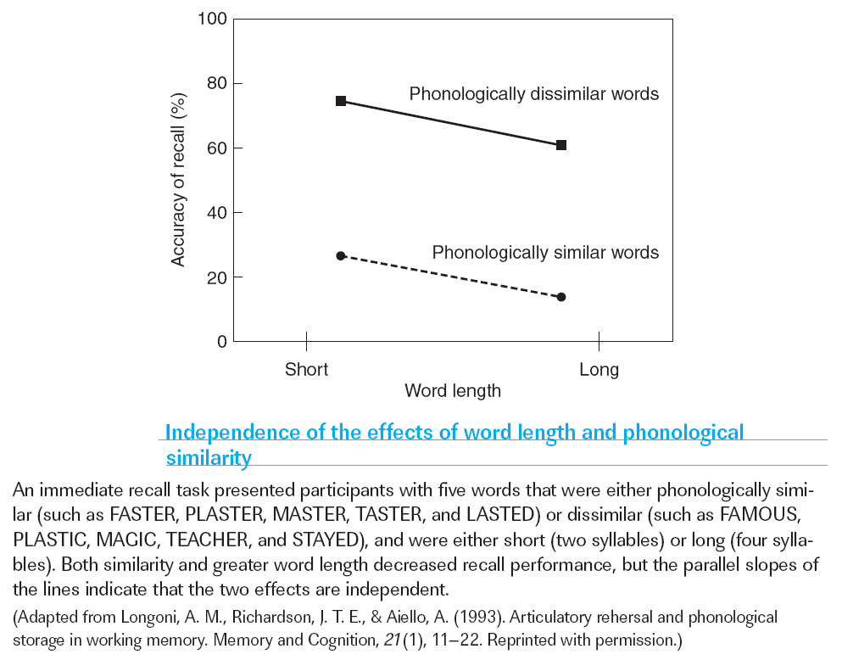
The Phonological Loop: When It Works and When It Doesn’t
Chapter 6

Slide 27
The Visiospatial Scratchpad
Mental navigation is an inherently spatial process.
The subjective experience of moving the mind’s eye from one spatial location to another also suggests the possibility that visuospatial working memory depends on brain systems that plan movements of the eyes (or possibly other parts of the body), just as verbal working memory depends on brain systems involved with planning speech.
Interestingly, this movement planning system might also be the basis for spatial rehearsal, the process of mentally refreshing stored locations to keep them highly accessible.
Chapter 6

Slide 28
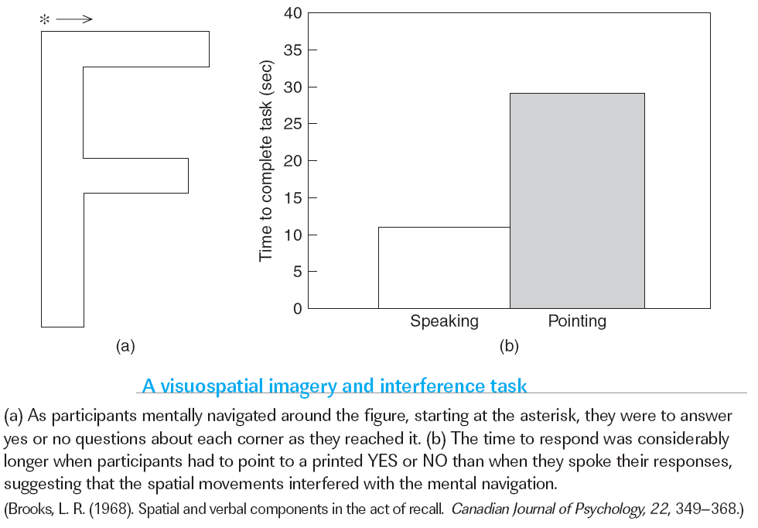
The Visiospatial Scratchpad
Chapter 6

Slide 29
The Central Executive
The component that most strongly differentiates the idea of working memory from the earlier conceptions of “short-term memory” is the central executive.
The notion of a central executive is supported by studies that show a dissociation between the functions listed above and the operation of the two storage systems.
These investigations often involve the problem of dual-task coordination, that is, the process of simultaneously performing two distinct tasks, each of which typically involves storage of information in working memory.
Chapter 6

Slide 30
The Central Executive
Content-based organization: spatial and object information is maintained in different regions.
The neuroimaging data in humans have not reliably supported such distinctions in the location of prefrontal cortex activity based on the content of working memory.
Process-based organization: storage and executive control processes are carried out in different regions.
Chapter 6

Slide 31
Measuring WM Capacity
Letter span
Digit span
Word span

Slide 32
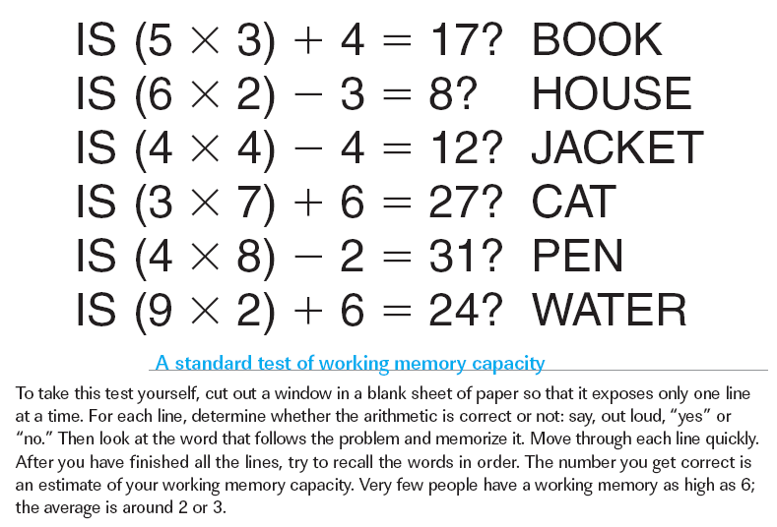
Implications of the Nature of Working Memory
Chapter 6
Notes:
Comprehension Check:
1. Give an example of an everyday situation in which you would need to use work­ing memory.
2. If working memory were a capacity of a computer, what component might it correspond to, and why?

Slide 33
Measuring WM Capacity
Matrix span
Rotation span
Reading span (Daneman & Carpenter)
Operation span (Engle)

Slide 34
Is (4 / 2) + 5 = 9? ROAD
Is (10 / 2) + 3 = 7? DOUBT
Is (2 * 3) + 2 = 8? SMILE
???

Slide 35
Working Memory: Issues
Related to many other fields of study:
  Attention
    Anti Saccade
    Cocktail Party Effect
  Inhibition
  Expertise

Slide 36
WM as Controlled Attention
Engle & colleagues
WM = STM + Controlled Attention
High span → Have a lot of control over attention
Notes:
High span → greater control of allocation of attention

Slide 37
Anti-Saccade Task
+

Slide 38
Anti-Saccade Task
+
*

Slide 39
WM & Cocktail Party
Low spans heard own name
  ~65-70%
High spans heard own name
  ~20%

Slide 40
WM & Inhibition
Hasher & Zacks (1988)
WM = control of the contents of STM
  Inhibition

Slide 41
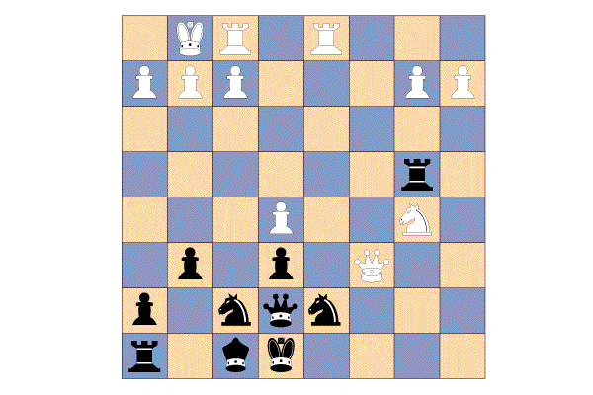
Expertise: The Value of Chunking
Possible arrangements:
  Novices: ~5-8 pieces
  Grandmasters: ~20 pieces
Random arrangements:
  Novices: ~5-8
  Grandmasters: ~5-8
Notes:
Figure 6.6 from:
Kassin, S. (2001). Psychology, third edition. Upper Saddle River, NJ: Prentice Hall.

